Slide 1
Supplier Finding Closure Workflow Updates
Feb 2025

Slide 2
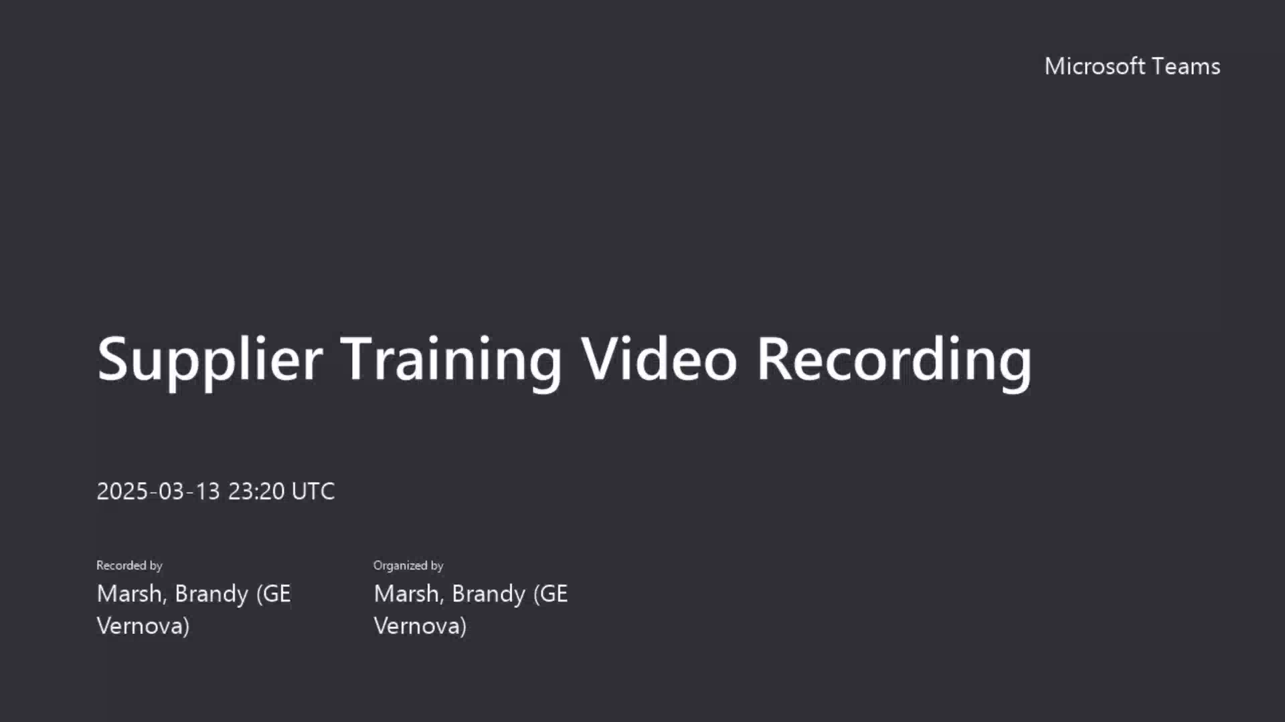

Slide 3
Updated SRG Audit Workflow in the Gensuite System
GE Auditors
Supplier Contacts
Overview of the Updated Supplier Finding Closure Process
When GE Auditors create findings during a supplier audit, a notification email will be sent to the Supplier Contacts through the SRG Gensuite System. This email will include finding details and indicate that you are responsible for providing the correction status and closing the findings in the system.
To close the findings, Supplier Contacts should click on the attachment links provided for each finding in the email. This will grant them access to the offline finding form, where they can update the correction status and upload supporting documents as evidence.
After the Supplier Contacts have closed the findings, a notification email will be sent to the GE Closure Verifier, who will review the submissions to decide whether the findings can be closed or if they need to be rejected (reopened for further corrections).
If the GE Closure Verifier decides to reject the closure of a finding, the status will revert to "Open“. At the same time, another notification email will be sent to the Supplier Contacts, informing them of the rejection and including any comments related to the decision. In this case, Supplier Contacts will need to click the attachment links in the email to update the correction status and close the findings again.
Additionally, a system Monthly Summary Notification email will be sent to Supplier Contacts for any opening findings.
Launch Audit and create finding items.
Close the findings via Email attachment links: Update corrective actions, provide status updates, and upload attachment files.
Verify finding closure – confirm or “reject” (reopen the item)

Slide 4
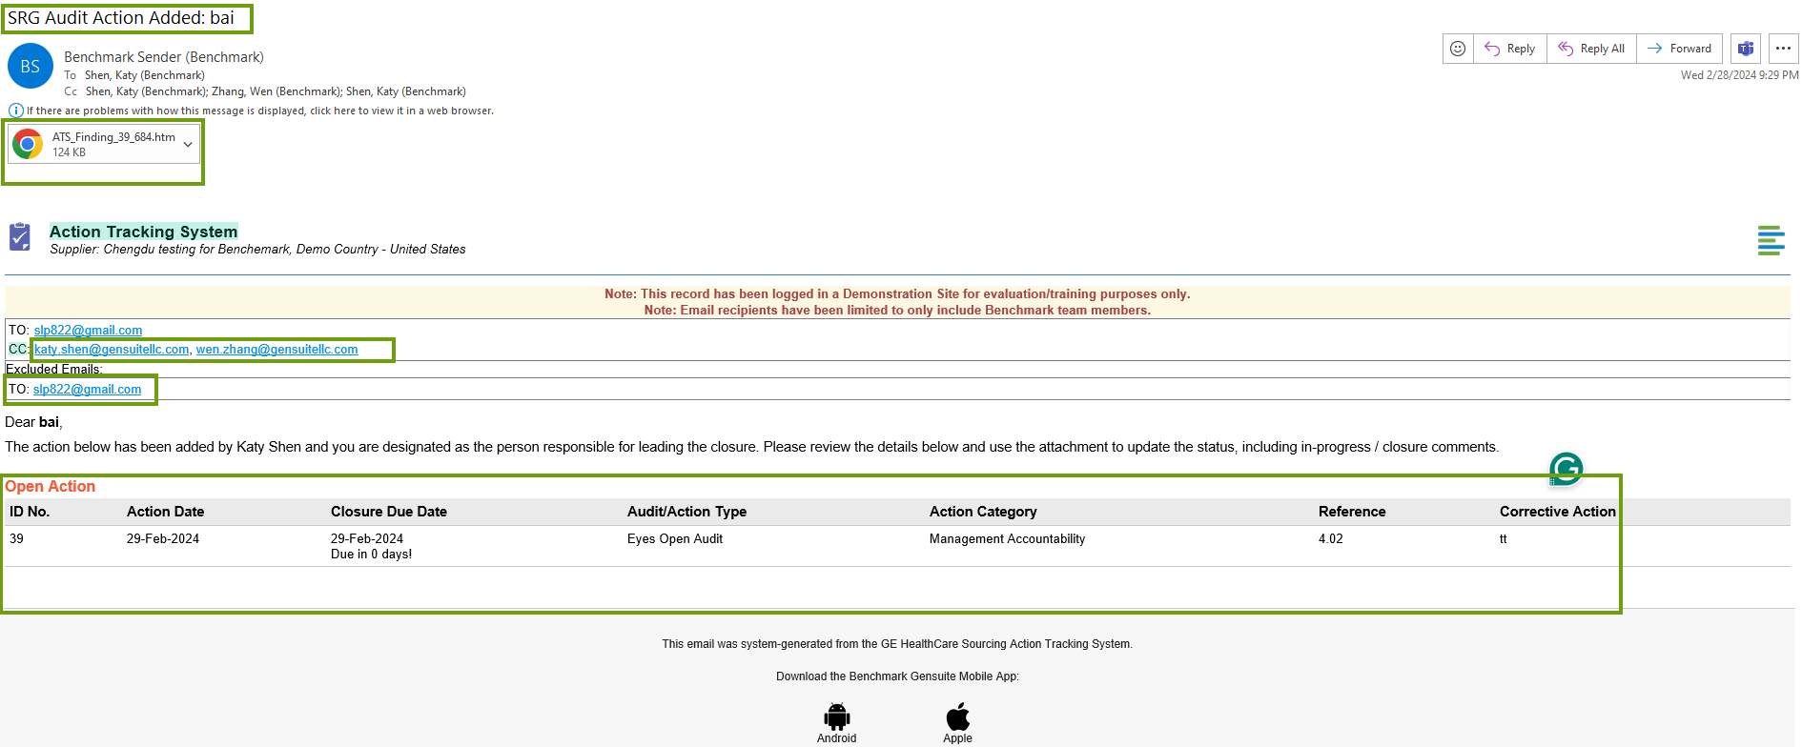
Sample Email: New Action Notification to Supplier
Title: Supplier name
Attachment: Indirect link for supplier to close action
①
To: Supplier email
CC: Auditor and Responsible Person
Show brief information about all open actions exported from this audit
Supplier Contacts will receive the above Gensuite system notification email when findings are documented by GE auditors. To close the findings, you can follow the below steps :
Step 1: Click the attachment in this email to access the offline finding closure form. (No Gensuite system account or application permission is required)

Slide 5
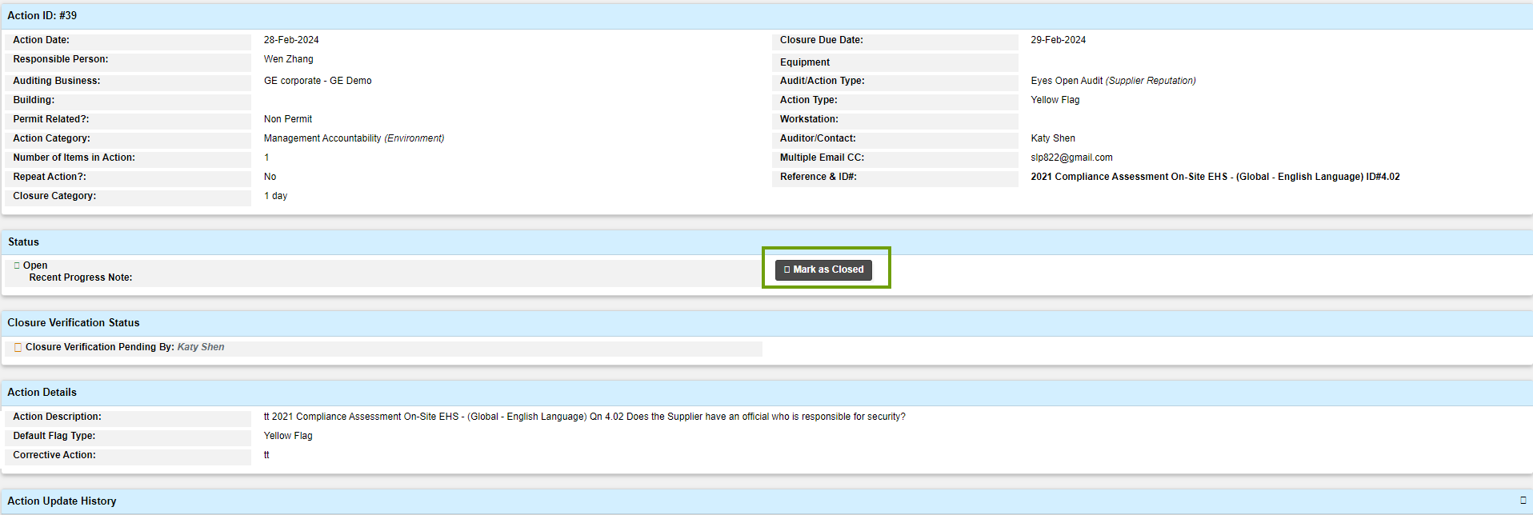
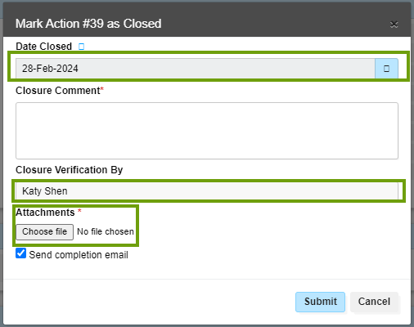
Email Attachment: Closure Page for Supplier
③
Date Closed locked as today
Click button for the Closure page
Closure Comment is mandatory. Fill in the Comment.
②
Closure Verifier locked
Attachment is mandatory.
Only one file with a max file size of 10MB is allowed to upload.
④
Step 2: In the offline finding form, click the “Mark as Closed” button, and a closure window will appear.
Step 3: In the closure pop-up window, complete the two required fields.
Closure Comment - Enter your comments in the Closure Comment field.
Attachments Field - Click Choose File to upload the material/evidence for the finding closure.
(Note: Only one file with a maximum size of 10MB can be uploaded. If you have multiple files, please combine them into a single file before uploading).
Step 4: Click the Submit button to send the form.
Note: The Action status will be updated in a few minutes after submission. The System will record the latest submission as the final result; please do not make multiple submissions.

Slide 6
Supplier Finding Closure Guidelines
Satisfactory finding closure includes
Corrective action is complete and not future tense, scheduled actions will not be accepted
Examples of unacceptable actions include:
Permit will arrive later this year
Parts are on order
PO has been issued
Detailed corrective action information is provided
Evidence attached supports the corrective action
Before and after photos
Updated policy with changes- with revision date
Training records- including dates, attendees, and signatures
*Unsatisfactory closure and evidence will result in the rejection of the finding closure

Slide 7
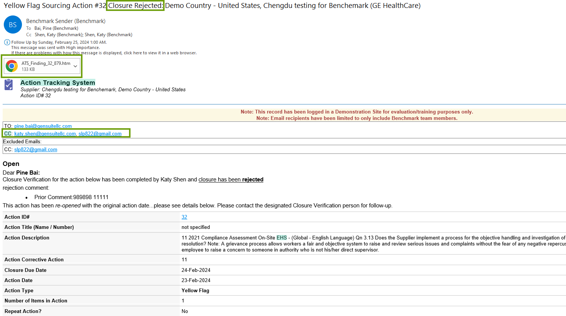
Sample Email: Closure Reject Notification to Supplier
Title: Action Closure Reject
Attachment: Indirect link for supplier to close action
To: Responsible Person
CC: Supplier email
Supplier Contacts will receive the above Gensuite system notification email when the Closure verifier rejects the finding closure. If the finding is rejected, the status will automatically revert to Open.
To close the finding again, they can click the attachment, which directs them to the offline finding closure form where they need to provide the latest correction information to close the finding.

Slide 8
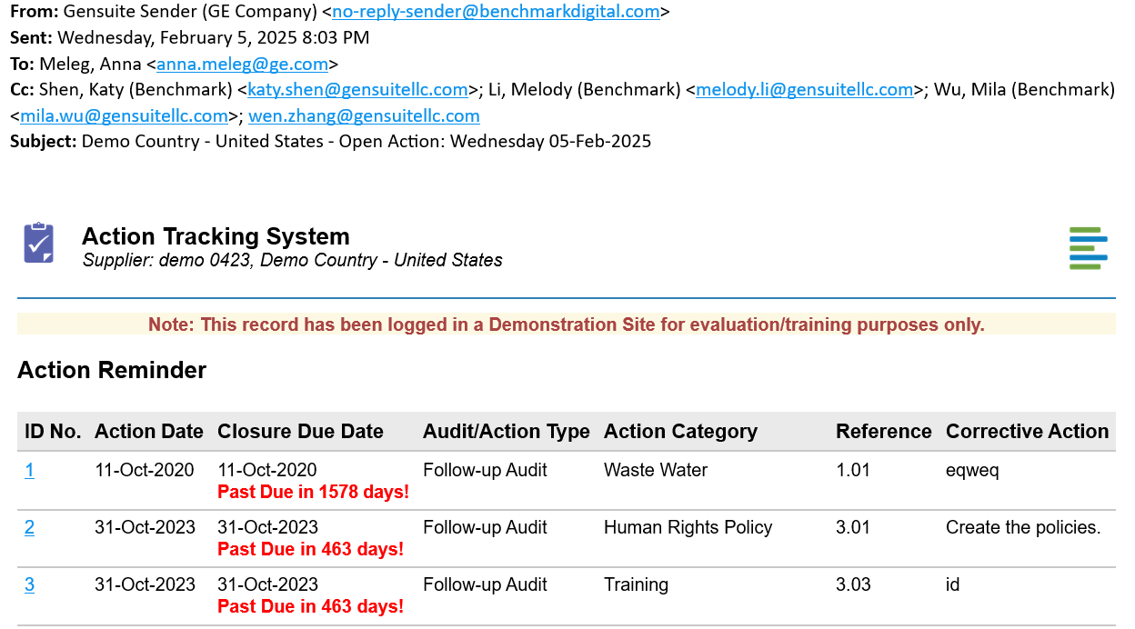
Sample Email: Monthly Notification to Supplier
To: Supplier email
Title: Open Actions for the supplier
Shows the Due Status of each open action
Supplier Contacts will receive the above monthly Gensuite system notification email if there are any findings with open status for the supplier.
To close the finding, they can click on the ID No. in the email body, which directs them to the offline finding closure form, where they need to provide the latest correction information to close the finding.

